Slide 1

Spark
Apache Spark is an open-source, distributed processing system used for big data workloads

Slide 2

Lecture CheckList
Introduction spark
Spark Installation
Spark Rdd
Spark Architecture
Spark Ml Lib
Spark Nlp
Spark Linear Regression
Spark Logistic Regression
Spark Decision Tree
Spark Naive Bayes

Slide 3
Spark Overview
Apache Spark is an open-source, distributed processing system used for big data workloads

Slide 4
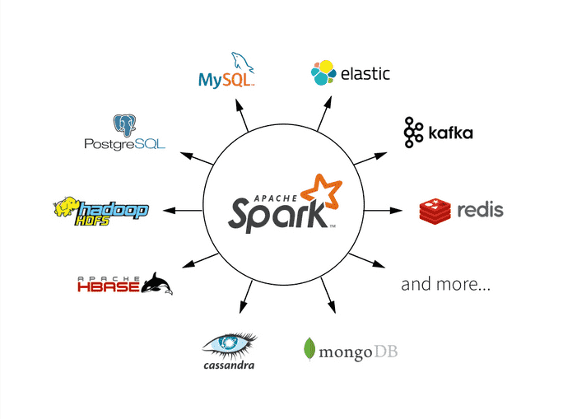
Apache Spark is an open-source, distributed processing system used for big data workloads. It utilizes in-memory caching and optimized query execution for fast queries against data of any size. Simply put, Spark is a fast and general engine for large-scale data processing.

Slide 5
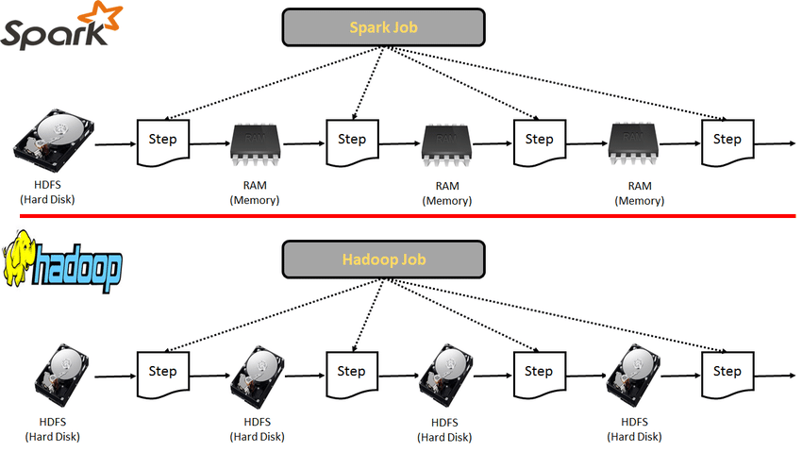
Difference Between Hadoop and Spark

Slide 6
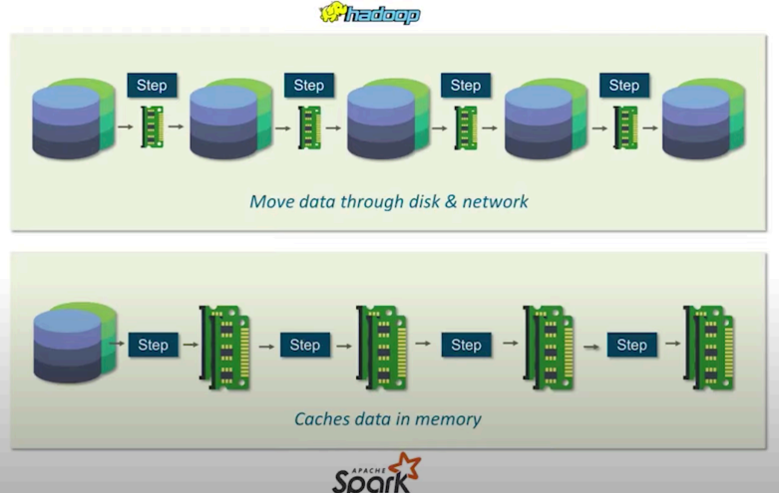
Difference Between Hadoop and Spark

Slide 7
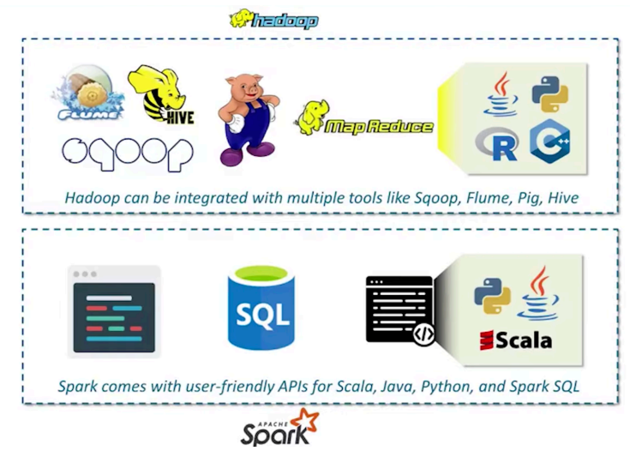
Difference Between Hadoop and Spark

Slide 8
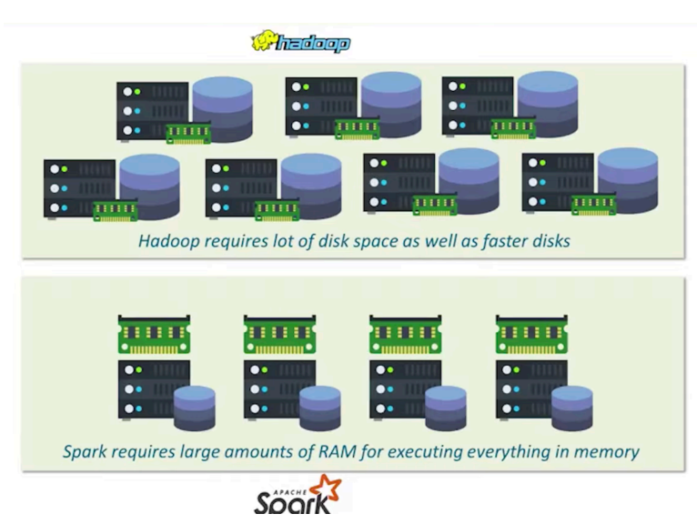
Difference Between Hadoop and Spark

Slide 9
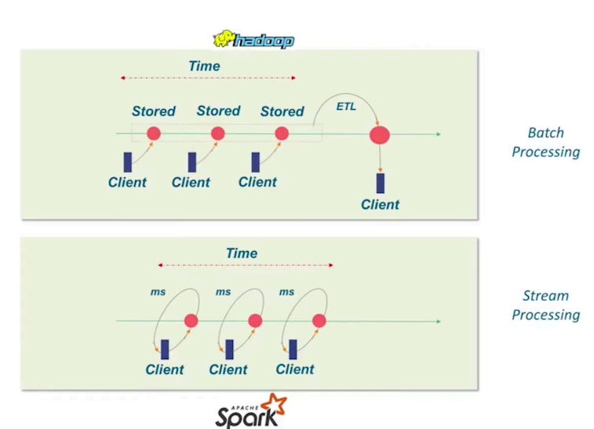
Difference Between Hadoop and Spark

Slide 10
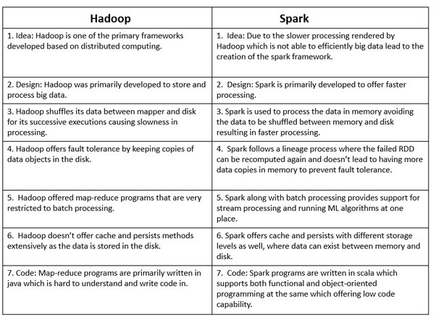

Slide 11
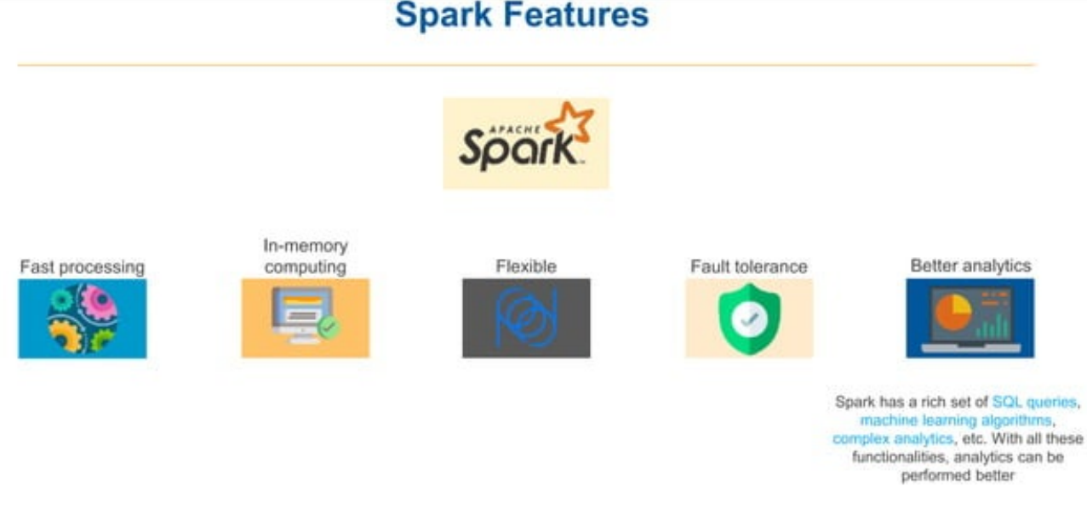

Slide 12
Resilient distributed datasets - RDDs

Slide 13
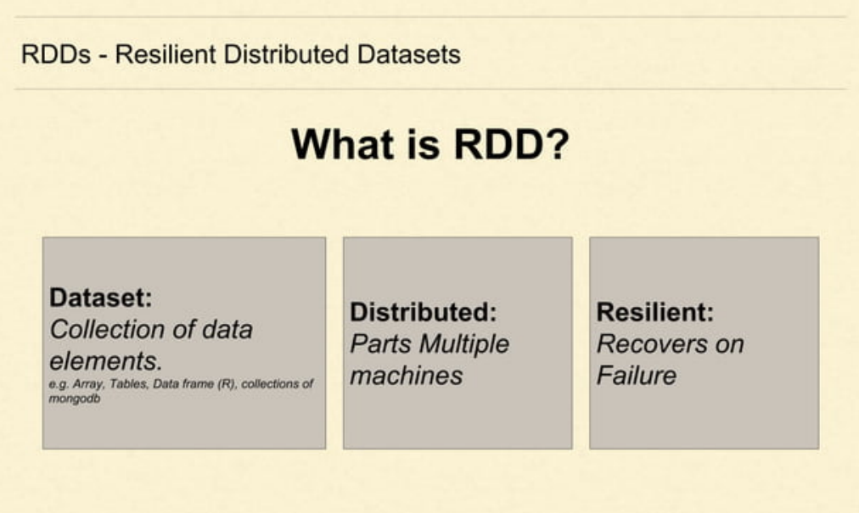

Slide 14
What is RDD?
Spark tightly controls what you do with the dataset. You cannot work with data in Spark without RDD.
To refer your dataset in Spark you will use the functions provided by Spark and those functions will create a RDD behind the scenes.
Can you join two datasets in spark? Of course you can using the join function provided by Spark and internally the join function will result in a RDD.
Can you do aggregation in your dataset? Of course you can, Spark provides functions for that too and spark will create a RDD behind the scenes any time you attempt to transform the data.
In short, Spark controls any operations that you do with your dataset, to perform any meaningful operation with your data you need to use functions provided by Spark and it will result in RDD.
This way Spark can keep track of everything that you are trying to do with the dataset and this is referred to as lineage and this helps Spark deal with tolerating failures effectively, which by the way is a very big deal in in-memory computing.

Slide 15
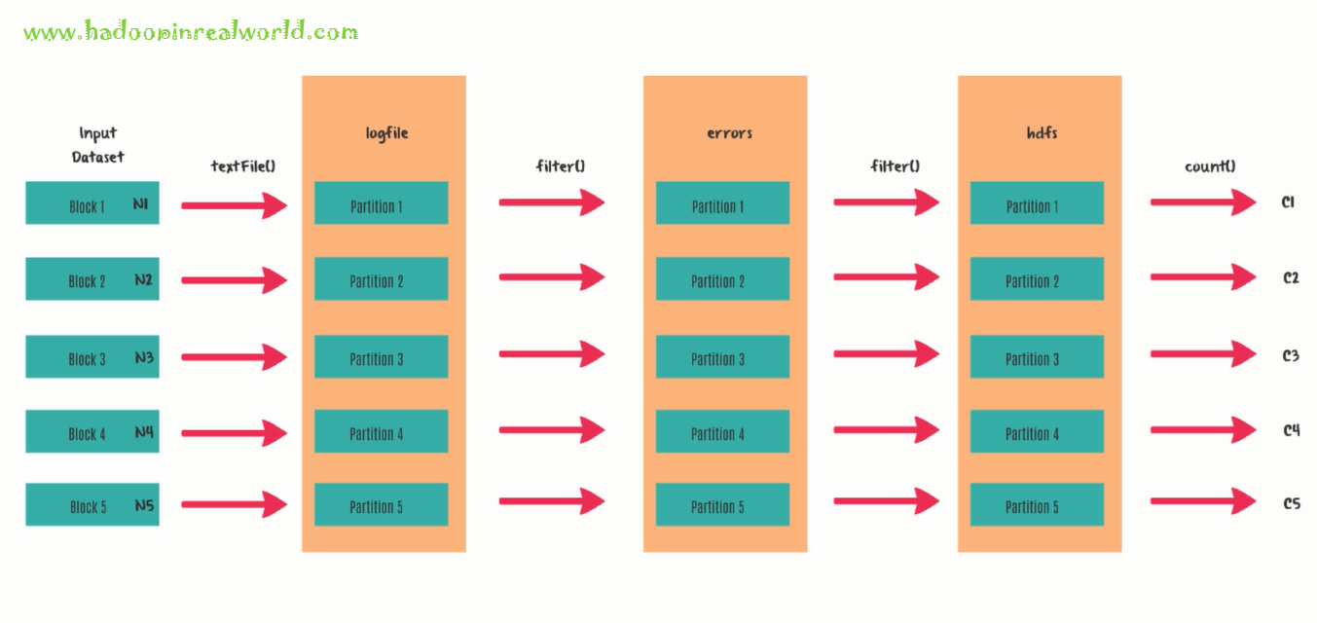

Slide 16
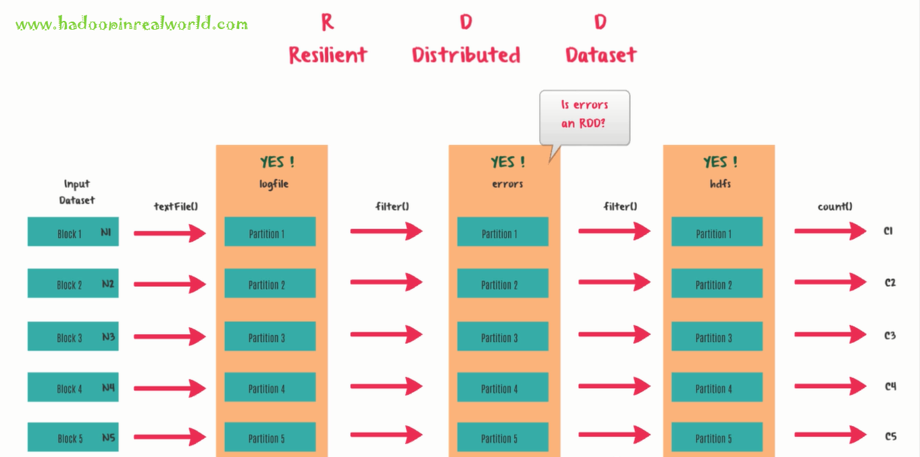

Slide 17
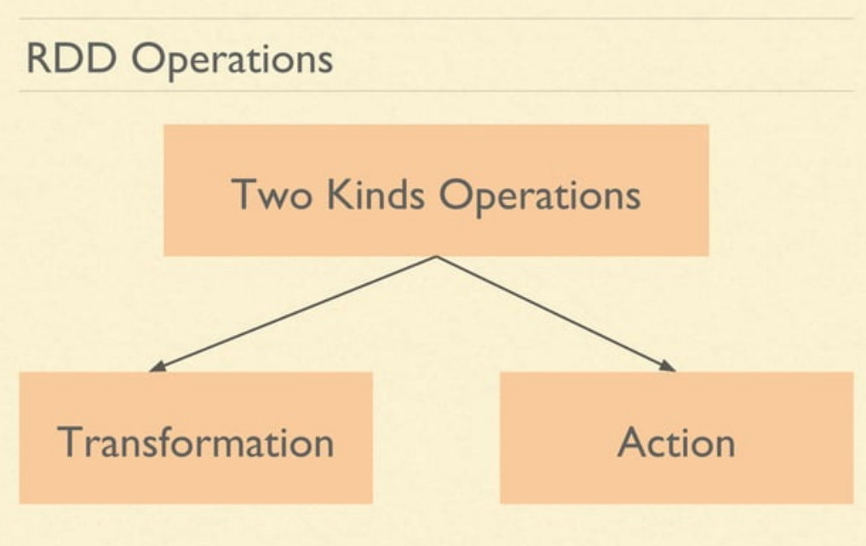

Slide 18
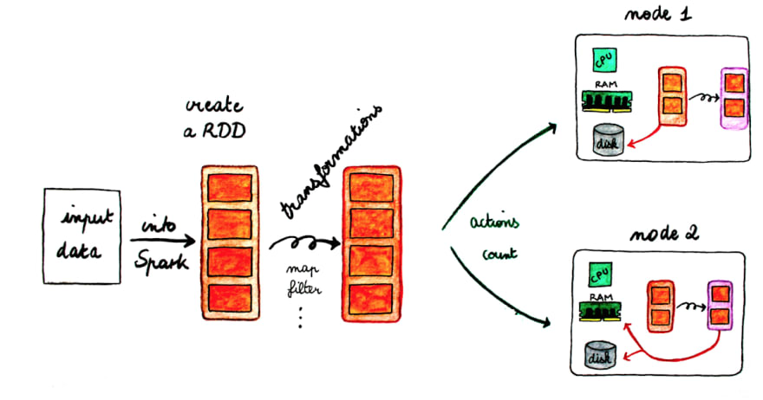

Slide 19
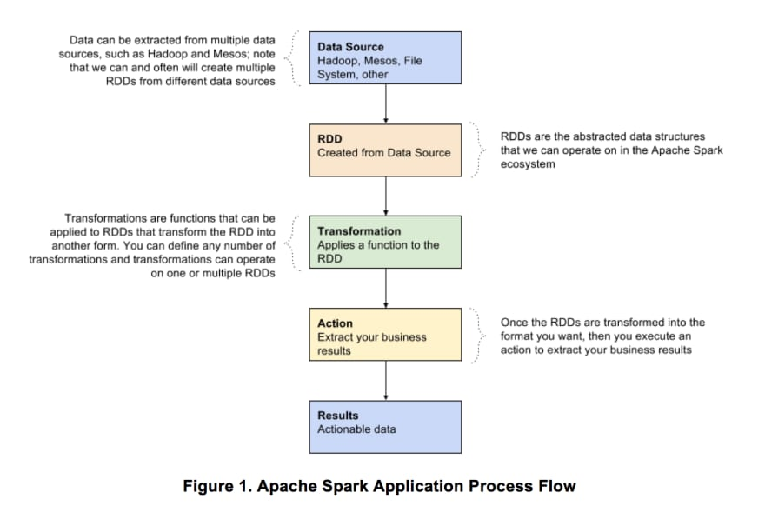

Slide 20
Spark Data Frame

Slide 21
A Data Frame is a Dataset organized into named columns. It is conceptually equivalent to a table in a relational database or a data frame in R/Python, but with richer optimizations under the hood. Data Frames can be constructed from a wide array of sources such as: structured data files, tables in Hive, external databases, or existing RDDs.

Slide 22
Spark Architecture

Slide 23
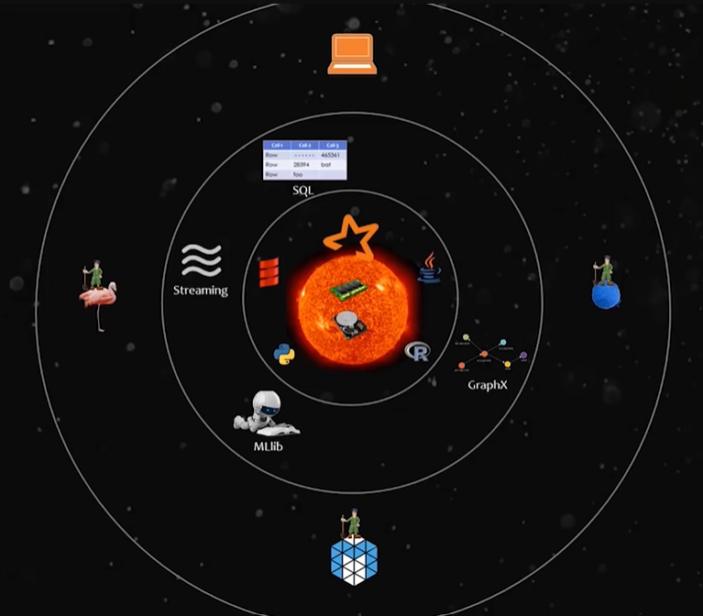

Slide 24
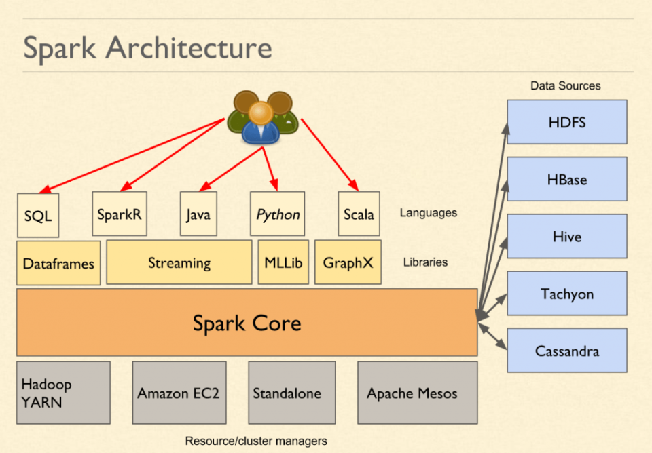

Slide 25
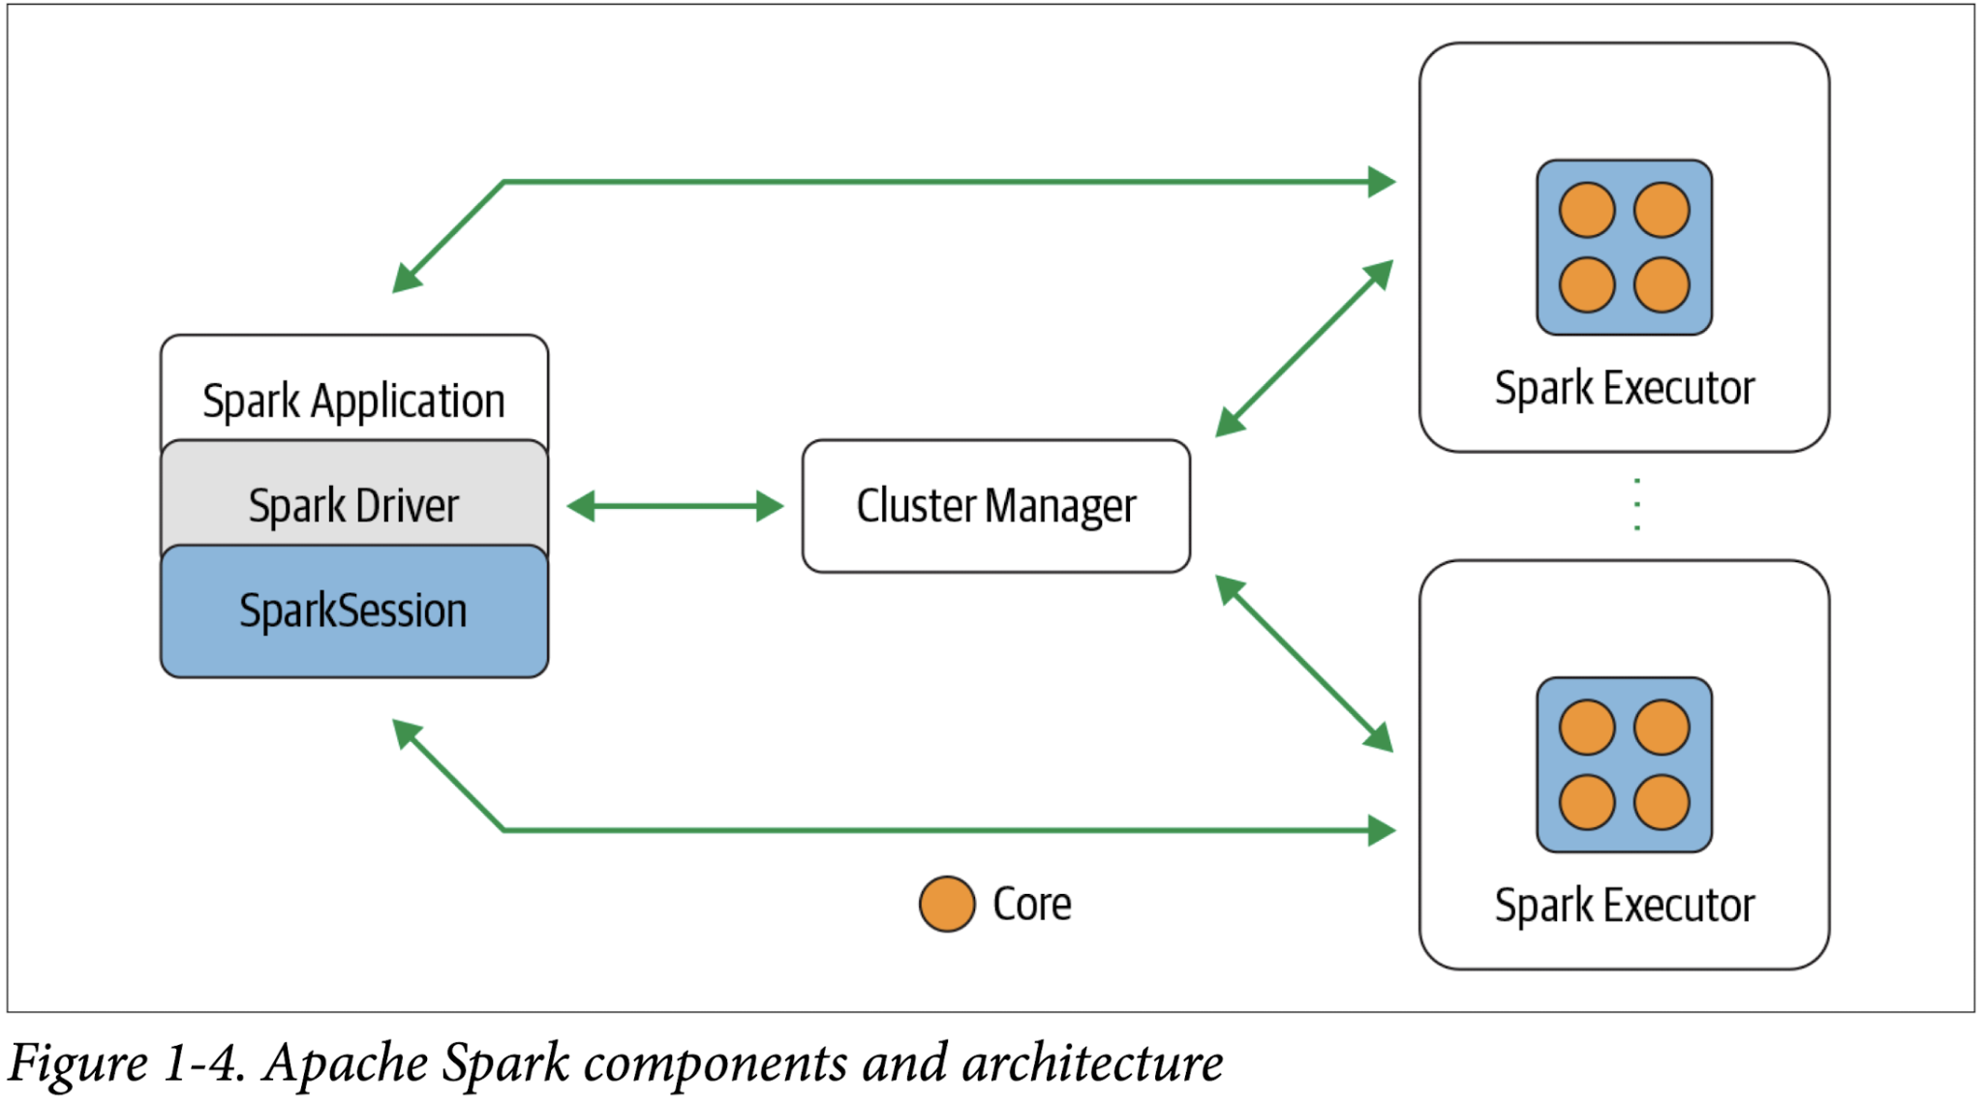

Slide 26
Spark Ml Lib

Slide 27
Spark MLlib is used to perform machine learning in Apache Spark. MLlib consists popular algorithms and utilities.
MLlib Overview:
spark.mllib contains the original API built on top of RDDs. It is currently in maintenance mode.
spark.ml provides higher level API built on top of Data Frames for constructing ML pipelines. spark.ml is the primary Machine Learning API for Spark at the moment.

Slide 28
Spark MLlib Tools
Spark MLlib provides the following tools:
ML Algorithms: ML Algorithms form the core of MLlib. These include common learning algorithms such as classification, regression, clustering and collaborative filtering.
Featurization: Featurization includes feature extraction, transformation, dimensionality reduction and selection.
Pipelines: Pipelines provide tools for constructing, evaluating and tuning ML Pipelines.
Persistence: Persistence helps in saving and loading algorithms, models and Pipelines.
Utilities: Utilities for linear algebra, statistics and data handling.
MLlib Algorithms
The popular algorithms and utilities in Spark MLlib are:
Basic Statistics
Regression
Classification
Recommendation System
Clustering
Dimensionality Reduction
Feature Extraction
Optimization

Slide 29
Spark Nlp

Slide 30
THANK YOU

